Slide 1

YORK REGION SOCCER ASSOCIATION
REFEREE EDUCATION SESSION
LAWS OF THE GAME
BY
York Region Referee Committee

Slide 2
YORK REGION SOCCER ASSOCIATION
REFEREE EDUCATION SESSION
Welcome back to another referee education session presented by the York Referee Soccer Association. Tonight’s session we will discuss the 3 videos you were sent and ask you to not only make a decision but to back your decision with the LOTG.
I encourage you to chat amongst your fellow referees. There are no bad question

Slide 3
Question 1
Let’s look at Video 1.
What is your decision?
Why?
Back up your answer with the LOTG.

Slide 4
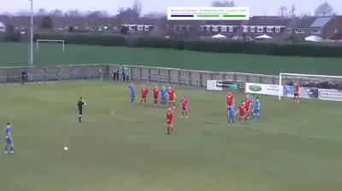
Question 1
Video 1

Slide 5
Answer 1
Direct free kick
A direct free kick is awarded if a player commits any of the following offences against an opponent in a manner considered by the referee to be careless, reckless or using excessive force:
tackles or challenges

Slide 6
Answer 1
Cautionable offences
A player is cautioned if guilty of:
• unsporting behavior
Cautions for unsporting behaviour
There are different circumstances when a player must be cautioned for unsporting behaviour including if a player:
• commits in a reckless manner a direct free kick offence

Slide 7
Answer 1
Cautions for unsporting behaviour
There are different circumstances when a player must be cautioned for unsporting behaviour including if a player:
• commits a foul which interferes with or stops a promising attack except where the referee awards a penalty kick for an offence which was an attempt to play the ball

Slide 8
Answer 1
The referee made the correct decision in
this match. #5 Blue committed a reckless challenge (yellow card) near the White Team penalty area. The referee correctly played advantage. #5 Blue then committed a 2nd foul at the other end of the field by breaking up a promising attack (yellow card). 2nd yellow in the same match equals a dismissal for #5 Blue.
**The 2nd foul committed by #5 Blue would qualify for a reckless challenge***

Slide 9
Question 2
Let’s look at Video 2.
What is your decision?
Why?
Back up your answer with the LOTG.

Slide 10
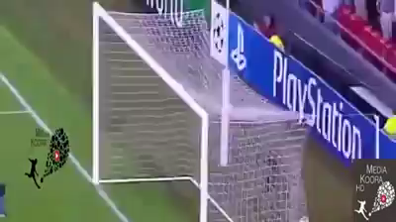
Question 2
Video 2

Slide 11
Answer 2
Offside Position
It is not an offence to be in an offside position
A player is in an offside position if:
-any part of the head, body or feet is in the opponents’ half (excluding the halfway line) and
-any part of the head, body or feet is nearer to the opponents’ goal line than both the ball and the second last opponent.

Slide 12
Answer 2
Offside Offence
A player is in an offside position at the moment the ball is played or touched by a team-mate is only penalized on becoming involved in active play by:
-Interfering with play by playing or touching a ball passed or touched by a team-mate
OR

Slide 13
Answer 2
Offside Offence
-Interfering with an opponent by:
-preventing an opponent from playing or being able to play the ball by clearly obstructing the opponent’s line of vision or
-challenging an opponent for the ball or
-clearly attempting to play a ball which is close when this action impacts on an opponent or
-making an obvious action which clearly impacts on the ability of an opponent to play the ball or

Slide 14
Answer 2
#20 Red was in an offside position. #20 Red ran towards the ball but did not touch it. #20 Red did not interfere with an opponent or the actions of any opponent. Teammate of #20 played the ball who was not in an offside position.
No offside.
GOAL

Slide 15
Question 3
Let’s look at Video 3.
What is your decision?
Why?
Back up your answer with the LOTG.

Slide 16
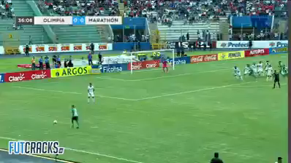
Question 3
Video 3

Slide 17
Answer 3
Indirect free kick
An indirect free kick is awarded if a player:
prevents the goalkeeper from releasing the ball from the hands or kicks or attempts to kick the ball when the goalkeeper is in the process of releasing it.
A goalkeeper cannot be challenged by an opponent when in control of the ball with the hands

Slide 18
Answer 3
The goalkeeper had the ball in his hands and was attempting to throw the ball. The Green Player jumped up in front of the goalkeeper as he was throwing the ball. This prevented the goalkeeper from releasing the ball . The referee in this video made the correct decision and awarded an indirect free kick to the White Team.
No fu.rther action (no caution)

Slide 19
Answer 3
Now if you believe this was not preventing the goalkeeper from releasing the ball then it is still no goal as the ball hit the Green Player in the head and went to a teammate in an offside position.
But the correct decision is indirect free kick for preventing the goalkeeper from releasing the ball.

Slide 20
Question 4
Bonus Video
Let’s look at Video 4.
What is your decision?
Why?
Back up your answer with the LOTG.

Slide 21
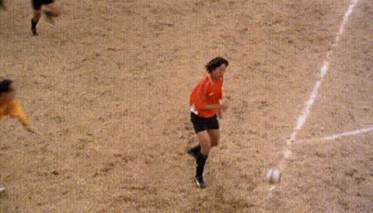
Question 4
Video 4

Slide 22
Answer 4
Gooooaaaalllll
I will leave it to you as a match official to decide what decision needs to be made in Video 4

Slide 23
YRSA REFEREE EDUCATION
This ends the presentation for tonight. The presentation will be available until 9pm for anyone that would like to go over any videos or questions. The session will also be posted on the YRSA website for anyone to use as a reference
Thank you for tuning in and have a good night.

